Slide 1
WEEKLY REPORT

Slide 2
DEF Outer Expansion

Slide 3
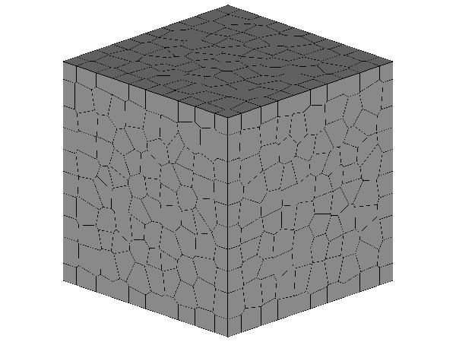
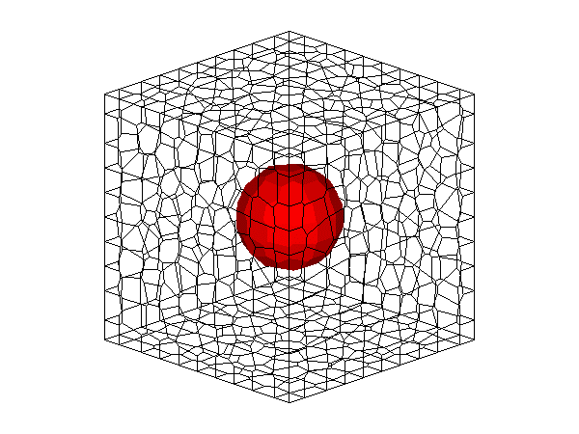
10 x 10 x 10mm Single Aggregate Model
10mm
10mm
10mm

Slide 4
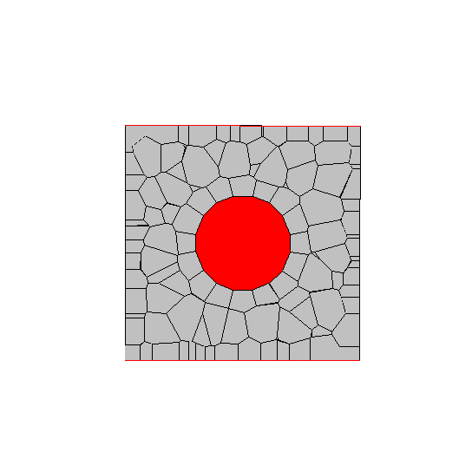

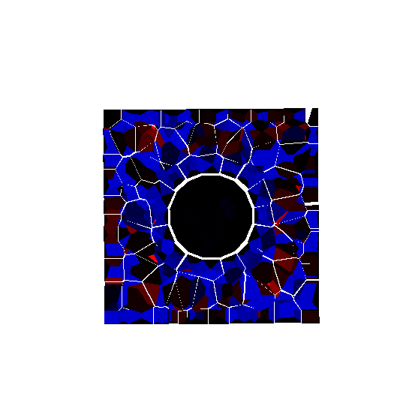
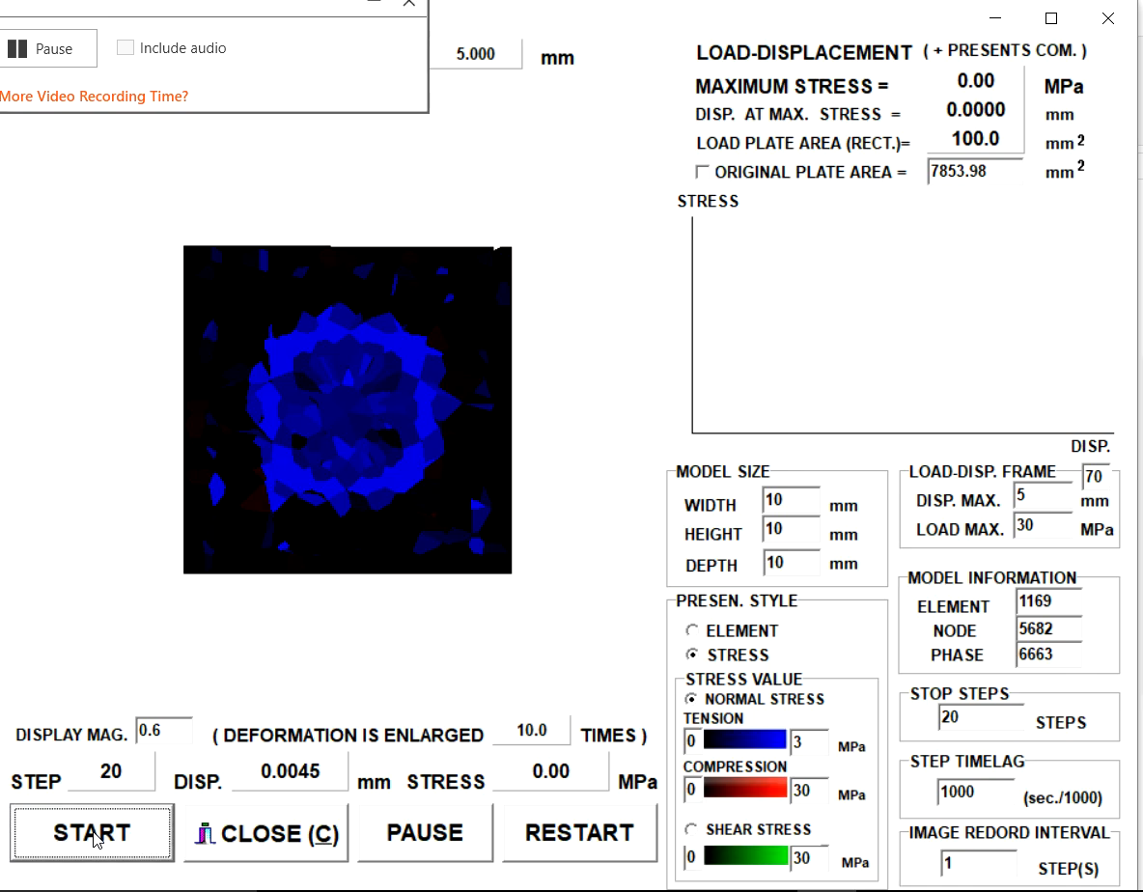
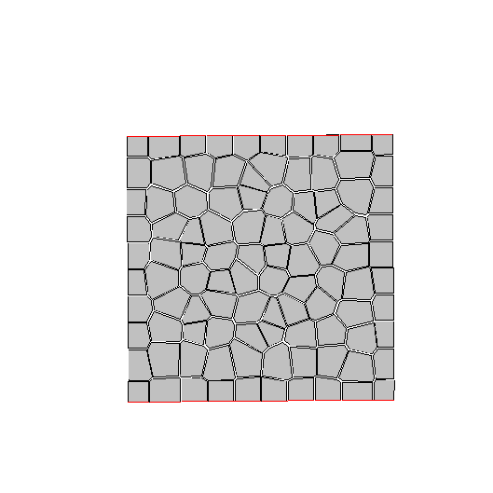

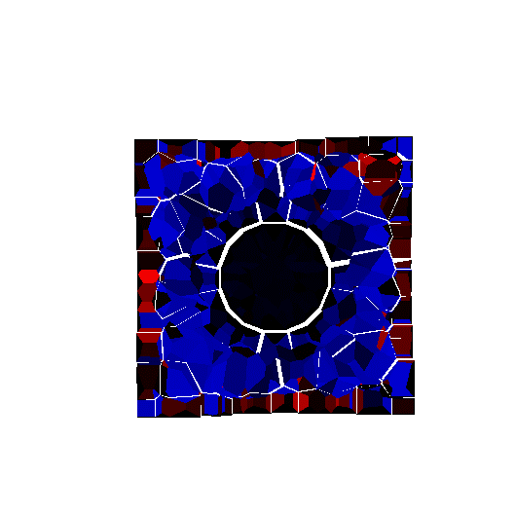
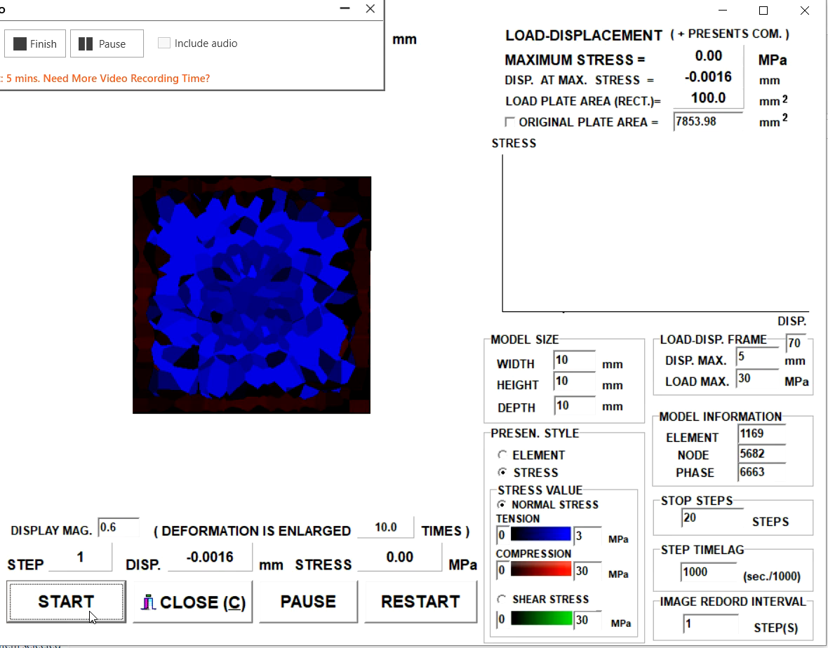
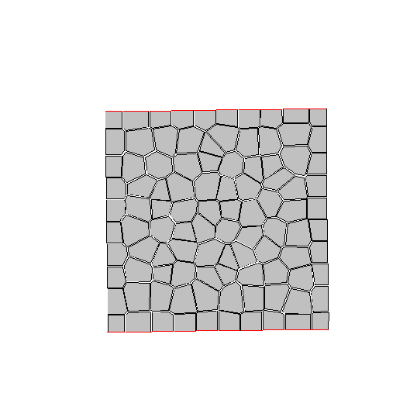
GIVE EXPANSION
2.5mm
NO
LOCALIZED
SURFACE CRACKING
STEP 1
STEP 20
Video
Surface View
(STEP 20)
10mm
OUTER PART
COMPRESSION
INNER PART TENSION
INNER CRACKING
(STRECHED BY OUTER PART DEFORMATION)
1.25mm
STEP 1
STEP 20
Video
Surface View
(STEP 20)
10mm

